Slide 1
SR UNIVERSITY
STU6422f769acb711680013161
R. POOJA REDDY
Week-03: DAX Functions on The Data
Production Analysis of Indian States

Slide 2
Explanation:
In Power BI we have to select for the Table view then we have to select for the New Measure
In that we have to write the formula that requires. Later we have to click enter.
After that go and select Report View in that Visualizations choose card chart and in that add the information that will show the results data.
In MSP it is same up to choosing formula then after that goes to total chart.
Now select format to visual and then general here select Effects in that change to fx .
As selecting format Style is field effect and then Select field as MSP.
Now we can observe the changes as required to the slicer settings.
Notes:
In Power BI we have to select for the tables view then we have to select for the New Measure In that we have to write the formula that requires.
Later we have to click enter.
After that go and select card chart and in that add the information that will show the results In msp it is same upto choosing formula then after that goes to total chart and select formate to visual and then general here fx in that change to

Slide 3
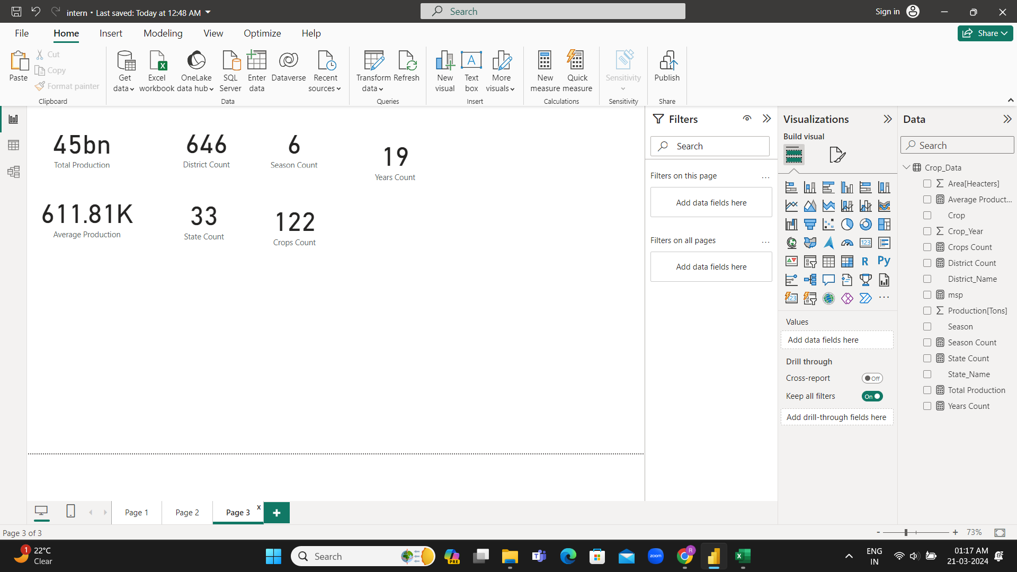
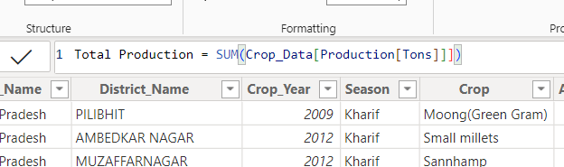
Total Production of The data :
The formula we used for Total Production:
Total Production = SUM(Crop_Data[Production[Tons]]])
Notes:
The formula we used for Total Production

Slide 4
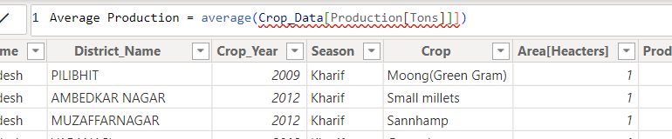
Average Production of The data :
The formula we used for Average Production:
Average Production = average(Crop_Data[Production[Tons]]])

Slide 5
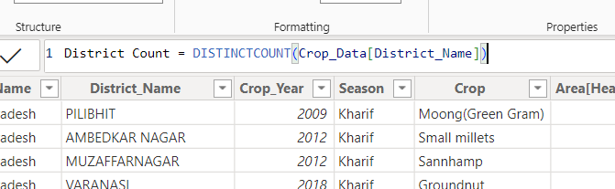
District Count of The data :
The formula we used for District Count:
District Count = DISTINCTCOUNT(Crop_Data[District_Name])

Slide 6
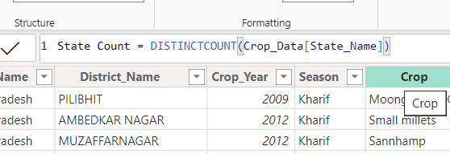
State Count of The data :
The formula we used for State Count:
State Count = DISTINCTCOUNT(Crop_Data[State_Name])

Slide 7
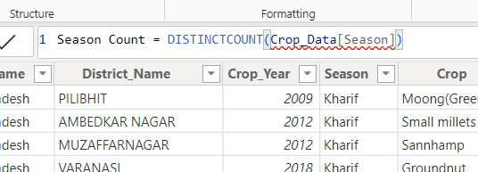
Season Count of The data :
The formula we used for Season Count:
Season Count = DISTINCTCOUNT(Crop_Data[Season])

Slide 8
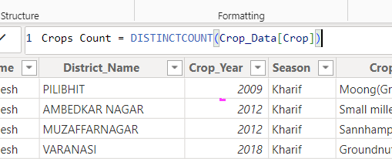
Crops Count of The data :
The formula we used for Crops Count:
Crops Count = DISTINCTCOUNT(Crop_Data[Crop])

Slide 9
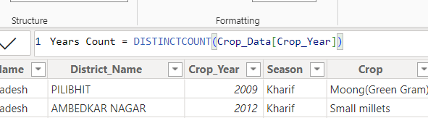
Years Count of The data :
The formula we used for Years Count:
Years Count = DISTINCTCOUNT(Crop_Data[Crop_Year])

Slide 10
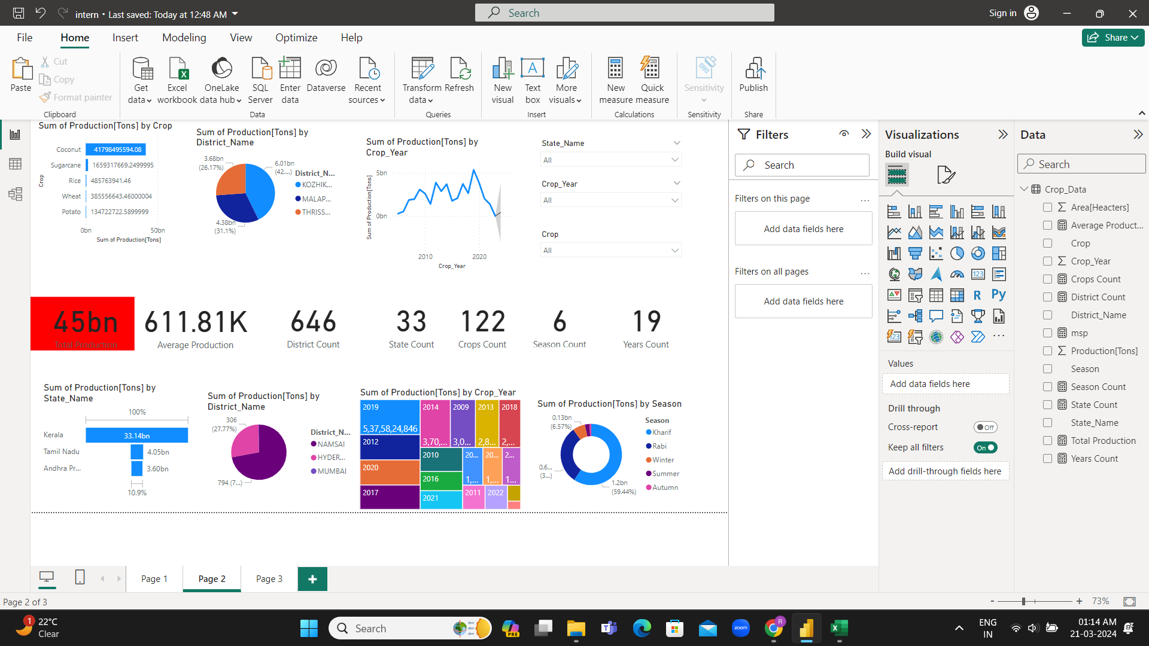
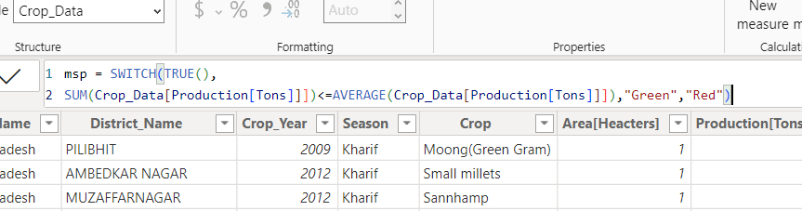
Minimum Supporting Price of The data :
The formula we used for MSP:
msp = SWITCH(TRUE(),
SUM(Crop_Data[Production[Tons]]])<=AVERAGE(Crop_Data[Production[Tons]]]),"Green","Red")

Slide 11
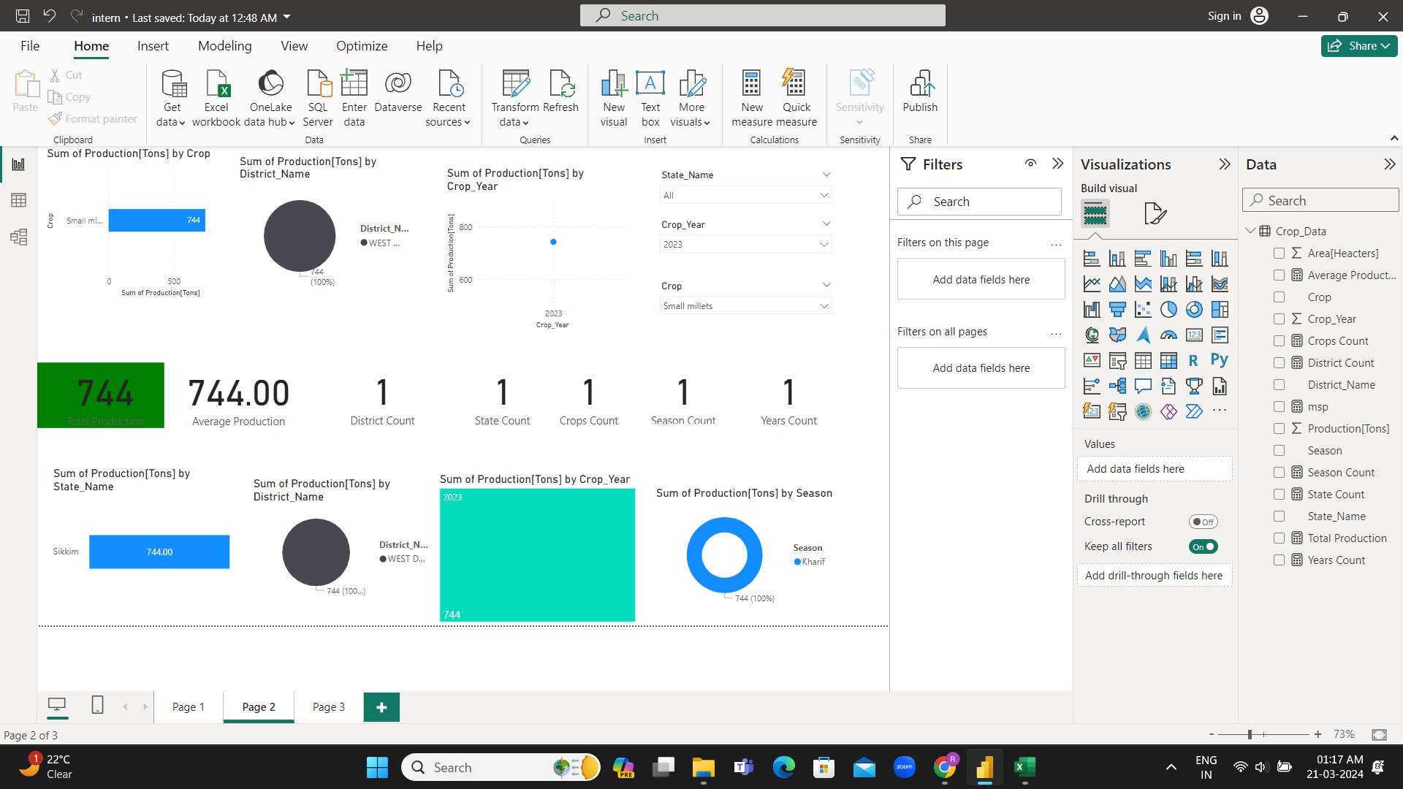
Summary :

Slide 12
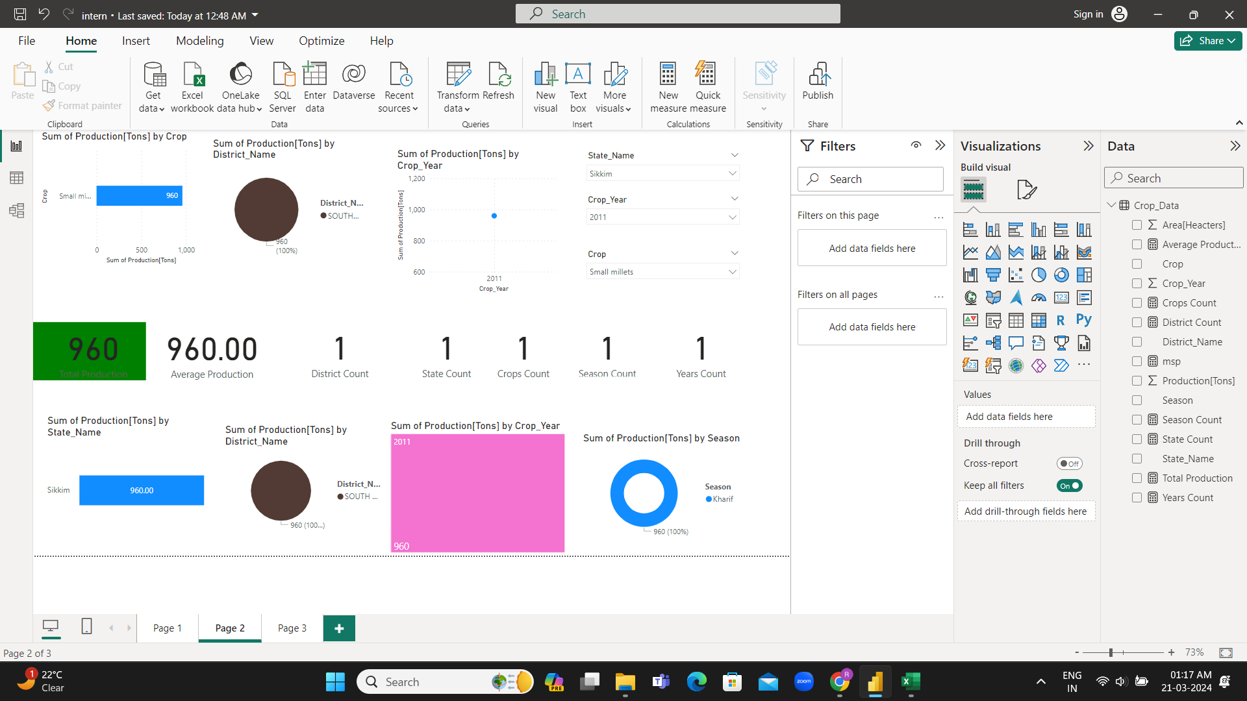

Slide 14


